Slide 1
Aircraft Brake-Pad Thickness Prediction through Machine Learning Algorithms
Begins at: Thursday, Aug 8th
R. Prakasam
HCL Technologies

Slide 2
Agenda
Introduction/Overview 5 min
Problem Statement 5 min
Solution Approach 15 min
Data used for Analysis 5 min
Analysis Process 20 min
Results Interpretation 5 min
Advantages, Considerations, Summary 5 min
Questions 10 min

Slide 3
Introduction/Overview
Solving Engineering Problems through modern Data Analytics
Preventive Maintenance through Machine Learning algorithms
Making use of historic data available to bring it to actionable solutions

Slide 4
Problem Statement
Brake pads in Aircraft tyres has to be replaced at the Right Time, before it gets worn-out. It is critical for the safety of the aircraft.
The prediction of the Nth landing of the aircraft, before which the Brake-pad should be replaced could help in identifying the Right Time to replace the Brake-pad.

Slide 5
Solution Approach
Collect the Historic data of the Aircraft’s previous Brake-Pad replacements.
Use this data for building a Predictive Model, based on Machine Learning Approach.
Apply the predictions from the model and find the replacement time for the Brake-Pad, so that wear-out failures are eliminated.

Slide 6
Solution Approach
Objective:
Predict the Brake-Pad thickness at nth Landing for an Aircraft , through a predictive model
Approach:
Use the Predictive Modelling Capabilities of R Language and build the Code. Develop an User-Interface through R-Shiny .Use this Interface to
Get Input Historic Data from the User
Build , Train and Test the Models with different Algorithms
Predict the Results for the Future, based on the Model Built
Display the predicted results On-Screen, without any coding required from the user

Slide 7
Solution Approach
Software Used:
R Version 3.4.1 (For Programming)
R Studio Version 1.0.153 (Integrated Development Environment (IDE) for R )
R Shiny Package (for building Interactive User Interface)
Excel (for Input Data storage)

Slide 8
Jargons to Understand
Predictive Modelling: is the process of applying a statistical model or data mining algorithm to data for the purpose of predicting new or future observations
Model: is the abstract representation of the data and its relationships in a given data set. A simple statement like “mortgage interest rate reduces with increase in credit score” is a model
Model Fit: refers to how well you approximate a target function
Training Set:A training dataset is a dataset of examples used for learning, that is to fit the parameters.
Test Set: A test set is a dataset of examples used only to assess the performance
Algorithm:a process or set of rules to be followed in calculations or other problem-solving operations, especially by a computer.
Overfitting refers to a model that models the training data too well. It negatively impact the models ability to generalize.
Underfitting refers to a model that can neither model the training data nor generalize to new data.

Slide 9
Solution Approach-Process Flow
Collect and Store the Historic Data as Excel File
Import the Data into R
*Automatic Process
Explore and Analyse the Data
Split the Data
75% Training Set
25% Test Set
Choose the Predictors
Build Predictive Model(s)
Validate Model
Choose the Algorithm
Get Model Performance
Get Predictions
Data-Set for which Prediction is Needed
Choose the Best Model

Slide 10
Data used for Analysis
Target Variable / Y Variable
Target/Dependent Variable | Sample Values
BrakePadThickness (in cm) | 2.6
Predictors / X Variables
INPUT DATASET KEY NUMBERS
100 Records/Samples
25 Predictors
10 Different Aircraft details

Slide 11
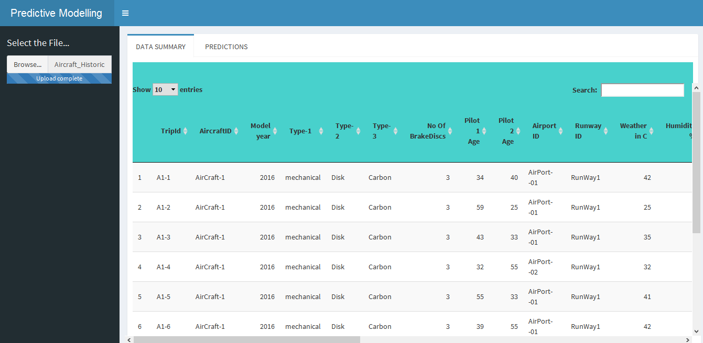
Analysis Process
IMPORTED DATA FROM EXCEL
1.Import the Data to R Environment

Slide 12
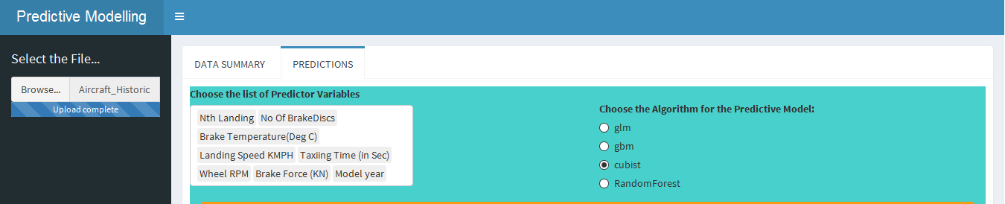
Analysis Process
2. Choose the Predictors
3. Choose an Algorithm for the Model
*After Choosing these 2 Parameters (Predictors and Algorithm), a Model will be Built With the Chosen Predictors and Trained with the chosen Algorithm automatically at the Backend
*Note: Target Variable is : BrakePadThickness

Slide 13
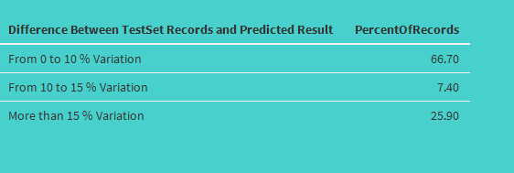
Analysis Process
4. Observe the Test Set Prediction Result. Repeat Steps 2 & 3 until, a model with minimum variation is found. That should be the Best Fit among the listed models, for the Data.
*Note: The Tool Automatically splits the Historic Data into 75 % Training Set and 25% Test Set. The Model learns from the Training Set and that learning is used for Predicting the Test Set(whose target variable is hidden to validate the accuracy of the Model).

Slide 14
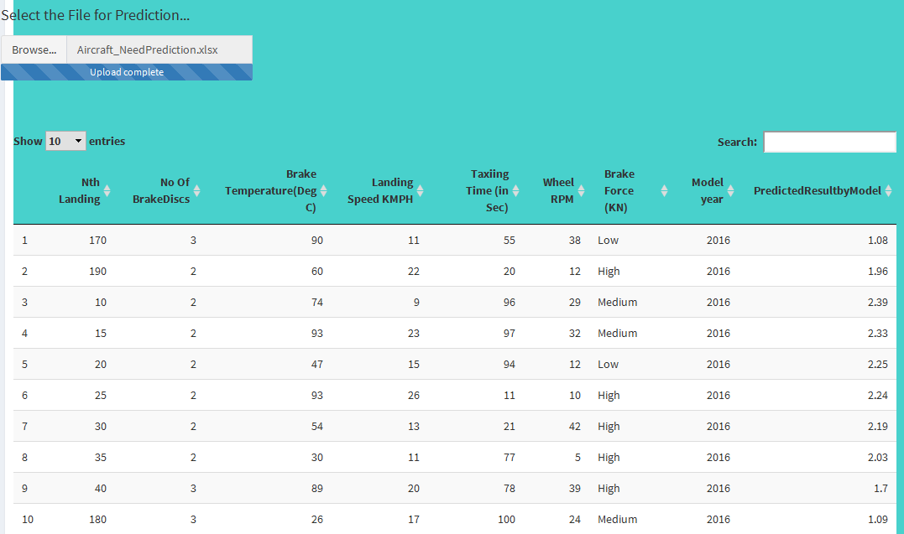
Analysis Process
5. Load the file for which Prediction is Required and get the Predicted Results

Slide 15
Result Interpretation
Future Predictions:
When there is an aircraft that has the following values
The “Brake-Wear out” Predicted is 1.08
*Note: The Prediction accuracy is depends on the Model and Predictors chosen in the above steps

Slide 16
Model Performance Factors
Factors that influence the Prediction Accuracy of the Model:
Clean Input Historic Data : With-Out Missing Values/Outliers
Feature Selection: Choosing the Right Predictors
Model Selection: Choosing the Appropriate Algorithm

Slide 17
Practical Implementation in Real-Time
1. Data Preparation
Step1a: Collect the Actual Historic Data (with Target Variable)
Step1b: Prepare a Dataset - The records for which predictions are needed
2. Model Building
Input the Collected Data into the tool and build the Predictive Model
3. Results
Obtain the Prediction results given by the tool .Use this value as the Expected Value/ Guidance Value, based on which strategic planning could be done.

Slide 18
Advantages
Prediction results are adaptive to data
No explicit calculations or rule formation needed to find the Target Variable
Data-driven Decision making
Solution available through Web Browsers after deployment

Slide 19
Considerations
General Considerations for Using the Approach:
The Choice of the model and selection of the Features have the direct impact on the Predictive Accuracy of the Model
The performance results on the Test Set are just indication metrics and not necessarily reflect in the Future Predictions, as the trained model could be a Overfit or an Underfit.
Most of the algorithms used for building the model are Black-box and unable to investigate the underlying calculations involved
Predictive modelling should not be considered an automated process. It involves lot of Human Judgement, Creativity and Common Sense
Could prove costly when implemented blindly
Predictive Model development is an iterative process , to be done until the best possible results are achieved

Slide 20
Summary
Preventive Maintenance achievable through Data Analytics
Similar kind of predictive modelling would help to solve many engineering based problems across multiple domains
Improved Solution accuracy achievable though a blend of Data Analytics Knowledge with Domain knowledge Expertise
Drive business decisions through Data, which is the so-called “Oil of the 21st century”

Slide 21
Links and References
Web URL For Modelling:
https://productanalytics.shinyapps.io/Aircraft/
Historic File –To Train the Model
File –To get Predictions
External Learning Material:
https://rstudio-pubs-static.s3.amazonaws.com/223423_8ca6fccca1e44939be3f85ecbfa9598f.html
https://www.analyticsvidhya.com/blog/2013/04/predictive-modeling-what-case-study-part-1/

Slide 22
Authors
R. Prakasam
B. Tech in Information Technology, 10 Years work experience in IT in the areas of Databases, Data Analytics and Machine Learning

Slide 23
Questions
Thank you for your attention.
Do you have any questions?

